Slide 1
ADHD
Attention Deficit Hyperactivity Disorder.
Emma Harrison
Social, Emotional and Mental Health.
Notes:
NICE, National Institute for Health and clinical Excellence.

Slide 2
Aims
To increase awareness and understanding of the needs of young people with ADHD
To share and explore good practice

Slide 3
Social, Emotional and Mental Health
Children and young people may experience a wide range of social and emotional difficulties which manifest themselves in many ways. These may include becoming withdrawn or isolated, as well as displaying challenging, disruptive or disturbing behaviour. These behaviours may reflect underlying mental health difficulties such as anxiety or depression, self-harming, substance misuse, eating disorders or physical symptoms that are medically unexplained. Other children and young people may have disorders such as attention deficit disorder, attention deficit hyperactive disorder or attachment disorder.
Code of Practice 2014.

Slide 4
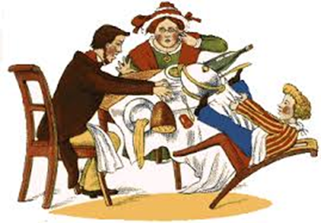
Historical perspective
1865

Slide 5
Historical Perspective
In 1902 a paediatrician, George Still, first described a group of children with common behaviour difficulties.
Stimulant medication was first used in 1937
By 1956 stimulants were more widely used and Ritalin came on the market
1980s
Increased research results in new symptoms being added
In 1994 Hyperkinetic Disorder referred to as ADHD.
NICE guidance 2019
Notes:
ADHD type behaviours have been around for a long time.
About 150 years ago references were found in a poem….
By 1902 one paediatrician had identified a group of children with common behaviours.

Slide 6
The brain and ADHD
The frontal lobes that enable us to control our concentration, thinking and behaviour do not function as well as in those with ADHD
Some of the pathways involving key chemicals that enable brain-cells to communicate with each other are disrupted

Slide 7
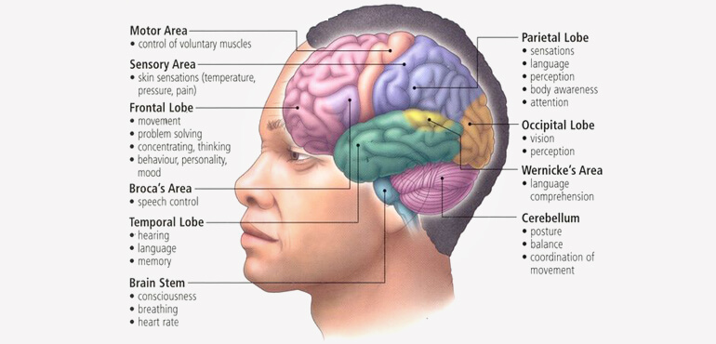

Slide 8
Diagnosis of ADHD
Should be made by a specialist psychiatrist or other healthcare professional with training and expertise
CAMHS is now NELFT in Kent.
Diagnosis made when symptoms
Meet the criteria in DSM-V or ICD-10
(School staff must not diagnose ADHD on observational data alone but information that can be provided is valuable)
‘’Not enough social stimulation.’’
‘’Inappropriate boundaries from significant adults.’’
Notes:
3:1 ratio boys to girls
‘Absence of evidence is not evidence of absence’2004 Dawson & Guare

Slide 9
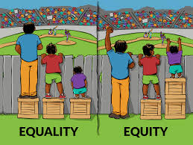
Be aware…..
A formal diagnosis of ADHD?
Looking at an individual holistically

Slide 10
Different profiles of ADHD
Inattention
Six or more symptoms up to the age of 16 years
Five or more symptoms for adolescents up to the age of 17, older or adults
Symptoms of inattention have been present for at least 6 months
Symptoms of inattention are inappropriate for the developmental level

Slide 11
Profile of inattention
Does not always give close attention to details or makes careless mistakes in schoolwork, at work, or with other activities.
Has trouble holding attention on tasks or play activities.
Maybe be listening even if does not appear to be
Does not follow through on instructions and fails to finish schoolwork, chores, or duties in the workplace (e.g, loses focus, side-tracked).
Often has trouble organising tasks and activities.

Slide 12
Often avoids, dislikes, or is reluctant to do tasks that require mental effort over a long period of time (such as schoolwork or homework)
Often loses things necessary for tasks and activities (e.g. school materials, pencils, books, tools, wallets, keys, paperwork, eyeglasses, mobile telephones)
Is often easily distracted
Is often forgetful in daily activities
May also hyper focus at times

Slide 13
Hyperactivity and Impulsivity
Six or more symptoms of hyperactivity-impulsivity for children up to age 16 years
Five or more for adolescents age 17 years and older and adults
Symptoms of hyperactivity-impulsivity have been present for at least 6 months to an extent that is disruptive and inappropriate for the person’s developmental level
Notes:
Low frustration tolerance
Poor planning ability
Responds emotionally not logically
Risk taking behaviour
Needs immediate rewards

Slide 14
Profile of Hyperactivity and Impulsivity
Often fidgets with or taps hands or feet, or squirms in seat
Leaves seat in situations when remaining seated is expected
Often runs about or climbs in situations where it is not appropriate (adolescents or adults may be limited to feeling restless)
Unable to play or take part in leisure activities quietly
Is often ‘on the go’ acting as if ‘driven by a motor’

Slide 15
Talks excessively
Blurts out an answer before a question has been completed
Often has trouble waiting their turn
Interrupts or intrudes on others (e.g, butts into conversations or games)

Slide 16
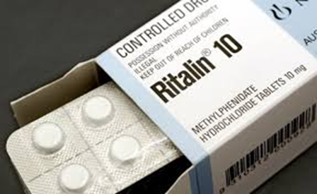
Medication
Parental choice
Consider the side effects
Regular review

Slide 17
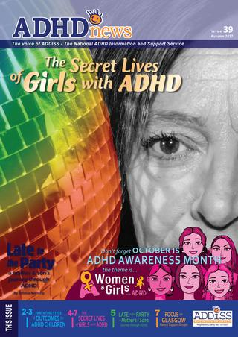

Slide 18
Secondary difficulties include
Relationship problems
Impact on learning, achievement, future prospects
Distracted by sensory factors
Impact on other areas of mental health
Potential to reveal another diagnosis
Any other difficulties?
Notes:
Around half will show symptoms in adulthood
More at risk of social difficulties, relationship breakdown, alcohol and drug abuse, criminal behaviour
Adults find environments that suit them
Have energy and talent

Slide 19
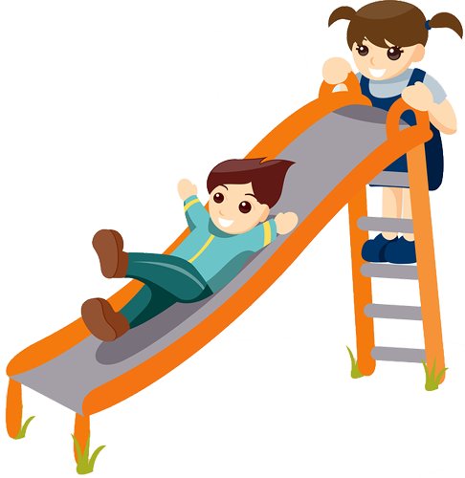
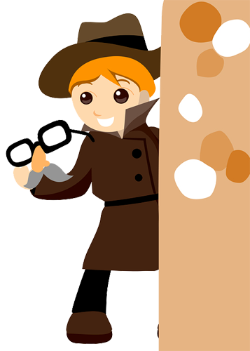
ADHD: The positives
May be open minded and creative and therefore enjoy subjects like art and drama
May be excitable and enthusiastic
May be full of energy and therefore enjoy sport and PE
May have a good sense of humour
Reference:
1. Compiled by Pathways Programme Steering Group
Notes:
It is easy to think of children with ADHD as a problem and a challenge to deal with. It is equally important to consider some of their strengths and as teachers to encourage children with ADHD to use their behaviours to fulfill their potential.
Reference:
1. Compiled by Pathways Programme Steering Group

Slide 20
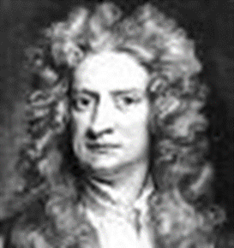
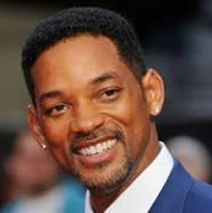

Slide 21
Strategies for Cognition and Learning
working slowly and steadily encourage children to take their time
short and varied tasks
teach organisational skills for routines
pre teaching of vocabulary
animated - enthusiastic teaching style/interactions
support for home learning sharing books and being consistent with expectations
encourage the young person to research
use of computers Ipad mobile phone
practical activities and interactive learning

Slide 22
Strategies for effective Communication and Interaction
to gain attention say the child’s name and make eye contact
be brief and to the point, giving one instruction at a time
use visual cues e.g. timetables, picture boards, schedules, vocabulary displays and hand gestures
inform child in advance of changes
vary voice, tone, volume and teaching methods
use the ‘Blue Peter’ effect
avoid sarcasm
are they an expert in a subject?

Slide 23
Strategies for Physical and Sensory Needs
the importance of reducing stress for example, through use of relaxation and physical exercise
consideration for physical organisation of the room
recognise and allow for movement- use of fidget toys, squeeze ball or designated fiddler. Doodling. Discussion of appropriate use
regular ‘brain breaks’
hand out books and resources
be aware that some sensory experiences are overwhelming for the individual

Slide 24
Strategies for Social, Emotional and Mental Health
use of distraction to avoid escalating behaviour
use of techniques such as, ignore, rules and praise
provide planned ‘learning breaks’ for short specified periods
describe the wanted behaviour. ‘’ Walk, thank-you.’’
circle time to model turn taking and social skills
adult modelling expected behaviour
use positive language
separate behaviour from the child- ‘’It’s what I do, it’s not who I am’’
give the child a responsibility/job
Identify areas to build young persons self esteem

Slide 25
Anything else………….?

Slide 26
An ADHD friendly setting or school
an understanding that children learn in different ways. Children with ADHD tend to be intuitive and need a practical approach to learning
an understanding of both the problems and the positive attributes
a non-judgemental approach. Reframe the language
a calm, encouraging and consistent environment with clear routines, rules and rewards.

Slide 27
An ADHD friendly setting or school cont’d
develops good home setting/school liaison that focuses on the positive and appropriate behaviour.
will value and listen to all children and adults.
provides a good extra-curricular programme where children can develop their strengths away from academic studies
or can recommend where parents and carers can access these

Slide 28
Some useful websites
www.addiss.co.uk
www.youngminds.org.uk
www.adhduk.co.uk
www.nice.org.uk
What is it really like to have ADHD- YouTube.

Slide 29
Any questions?
Please do not hesitate to contact me at:
E.Harrison@st-nicholas.kent.sch.uk

