Slide 1

Introduction to Effective Strategies for Maths, including Dyscalculia
Liz Ross, Specialist Teacher, with a focus on cognition and learning

Slide 2
Objectives:
To increase your understanding of the term dyscalculia
To increase your understanding of the learning process for individuals with dyscalculia/numeracy difficulties
To increase your understanding of the most effective strategies for supporting individuals with dyscalculia/numeracy difficulties

Slide 3





What can ‘five’ be?
5
Notes:
3

Slide 4
Shape, Space and Measure
Shape, space and measure lend themselves to being more concrete than number and operations

Slide 5
It might not be Dyscalculia!
Can you think of other reasons why the CYP may be having difficulties with maths and questions to ask about their learning generally to give you that wider picture of their learning profile?

Slide 6
Other possible Reasons for Difficulties with Maths
Absences
Previous maths teaching
Engagement
Difficulties that are apparent in other subjects
Any already identified difficulties

Slide 7
Another Question to ask...Is the CYP demonstrating Maths Anxiety?
Children with numeracy difficulties do not enjoy number work
Many develop avoidance strategies
Anxiety reduces the ability to think
Anxiety impedes memory
Self-fulfilling prophecy

Slide 8
Dyscalculia
‘…is a condition that affects the ability to acquire arithmetical skills…. learners may have difficulty understanding simple number concepts, lack an intuitive grasp of numbers, and have problems learning number facts and procedures. Even if they produce a correct answer or use a correct method, they may do so mechanically and without confidence.’
(DfES 2001)

Slide 9
Key indicators of Dyscalculia – Difficulties with Numerosity
Lack of subitizing skills
Lack of estimating skills
Difficulty with number comparisons

Slide 14
Causes of Dyscalculia
Dyscalculia is a deficit in the core capacity to process numbers
Congenital condition but can be acquired through brain injury
Between 3% and 6% of the population may be affected

Slide 15
Assessment
Assess CYP to find out what they can do as well as what they can’t do
Find out how they think about numbers

Slide 16
General Strategies for Supporting Numeracy Difficulties
Pattern building
Get CYP creating word problems from day one
Plan alternative ways of recording
Create a number rich environment
Use concrete resources
Get CYP explaining and talking about what they are doing

Slide 17
Teaching approaches need to:
Be understanding based (before any rote learning)
Be carefully structured
Encourage the active participation of pupils
Make maths learning a positive experience

Slide 18
Language!
Make vocabulary development a priority from the very first mathematical experiences
Pre-teach mathematical vocabulary for all new topics
In, on and from (positional terms) can mean the same to pupils with dyscalculia

Slide 19
Example Word Card for an Operation
addition
more total
add
and increase
+
sum of
plus
Notes:
19

Slide 20
add +
=
add
3 + 2 = 5
0 3 5
Notes:
20

Slide 21
Language!
Be mindful of your speech
- Can you spot the misleading word in these maths problems?
“Which one is three?” (referring to a number line)
“What’s the number before six?”
“Add five to four”
- Which phrase would you use to explain the equals sign in the following equation?
2x3=3x2
“is the same as” or “is the same amount as”

Slide 22
Language!
Use technical language like ‘equation’ from the beginning
Avoid ambiguous language
Which of these terms would you introduce first?
“Big” or “Biggest”
“More” or “Most”

Slide 23
Key Skills to Target
Digits
Numbers 10 to 20
Numbers to 100
Addition and Subtraction
Multiplication and division

Slide 24
Digits 0-9
Don’t rush! Overlearn and get it right!
COUNTING - One-to-one correspondence, cardinality, ordinal numbers, counting in different directions, counting sets, caterpillar tracks first
Beware of auditory confusion for `th’ `v’ and `f’
Certain dot patterns first
Subitising
Estimating

Slide 25
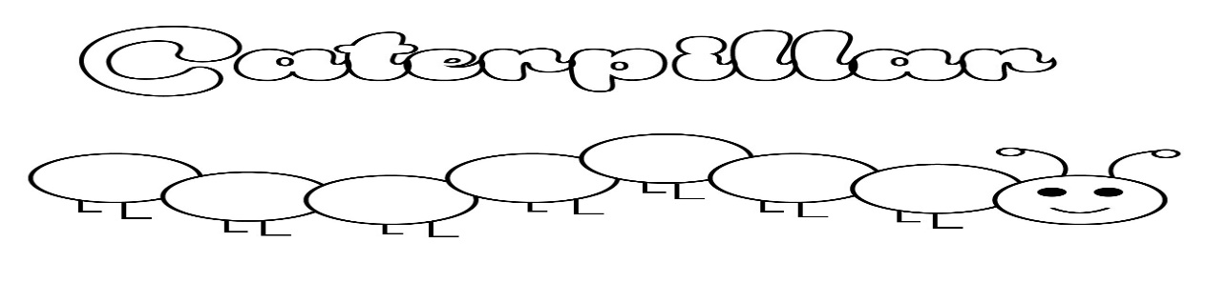
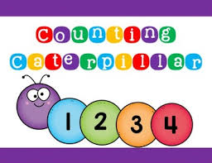
Number Tracks to Number Lines
Start with caterpillar tracks
Then move to numbered caterpillar tracks

Slide 26
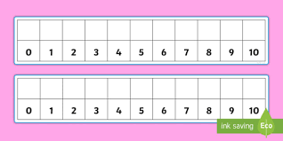
Full Number Lines

Slide 27
First Dot Patterns

Slide 29
2
Notes:
29

Slide 30
Numbers to 20
Some number names are very abstract eg. twelve
Model counting objects in lines of ten and single ones

Slide 31
Nearly Empty Number Line
0 5 10 15 20
0 10 20
Notes:
31

Slide 32
Numbers to 100
Concrete materials remain crucial
For example, Dienes equipment and Cuisenaire rods
Be careful when you introduce hundred squares
When CYP are ready, support the use of empty number lines

Slide 33
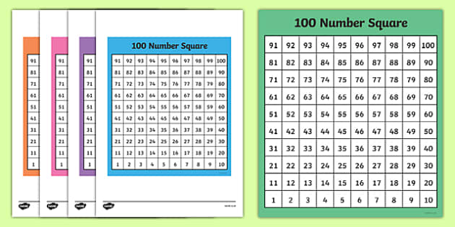

Slide 34
Empty Number Line
To add 36 and 22
+20
_______________________
_[_______________________]___________________________________
36 56
Then add on the 2
+20 +2
________________________ ______________
[_______________________ ][______________]_____________________
36 56 58
Notes:
34

Slide 35
Key Maths Skills - Operations
Counting
+ or – 1
+ or – 2
+ or – 10
Number bonds
Doubles
Nearly numbers and adjusting
Bridging through 10
Partitioning
Complementary addition

Slide 36
Key Numeracy Concepts for Learning Addition and Subtraction
First learn some basic number facts and then use them to work out the other facts
Understand that these are inverse operations – use concrete equipment and word problems to illustrate this fact …and then write the sums
Understand that addition (but not subtraction) is a reversible operation

Slide 37
Strategies for Teaching Multiplication and Division
Always teach these two operations simultaneously
Understand the concept of groups/sets
Build on the pupil’s understanding
Understand repeat addition and subtraction
Understand that multiplication and division are inverse operations
Understand that multiplication (but not division) is a reversible operation
Know multiplication and division facts

Slide 38
In Summary
Pupils with dyscalculia don’t have a basic `number starter’ kit
Determination of dyscalculia isn’t as important as effective intervention
Whole number and operations are abstract concepts, so find ways to make it real/concrete
Teaching approaches need to have four key elements:
1) Teaching is for understanding
2) Teaching is carefully structured
3) Teaching encourages the active participation of the pupil – multi-sensory
4) Teaching allows the pupils to feel that learning maths is a positive experience
Ensure that pupils have secure knowledge of the key maths skills listed in this training

Slide 39
Thank You
Thank you for completing this training. I hope it was helpful.
Please e-mail Nickie Perring-Redford at n.Perring-Redford@stns.org.uk to get an evaluation form and certificate?

