Slide 1


Using workstations to teach independence
A practical ‘how to’ guide
Sarah Beaumont – Canterbury Specialist Teaching & Learning Service

Slide 2
Aims of the session
To explore the purpose of using a workstation approach with pupils
To understand why a workstation approach can support the learning styles of some pupils with Autism or learning difficulties
To understand how to use a workstation to support pupils
To explore appropriate workstation resources and tasks

Slide 3
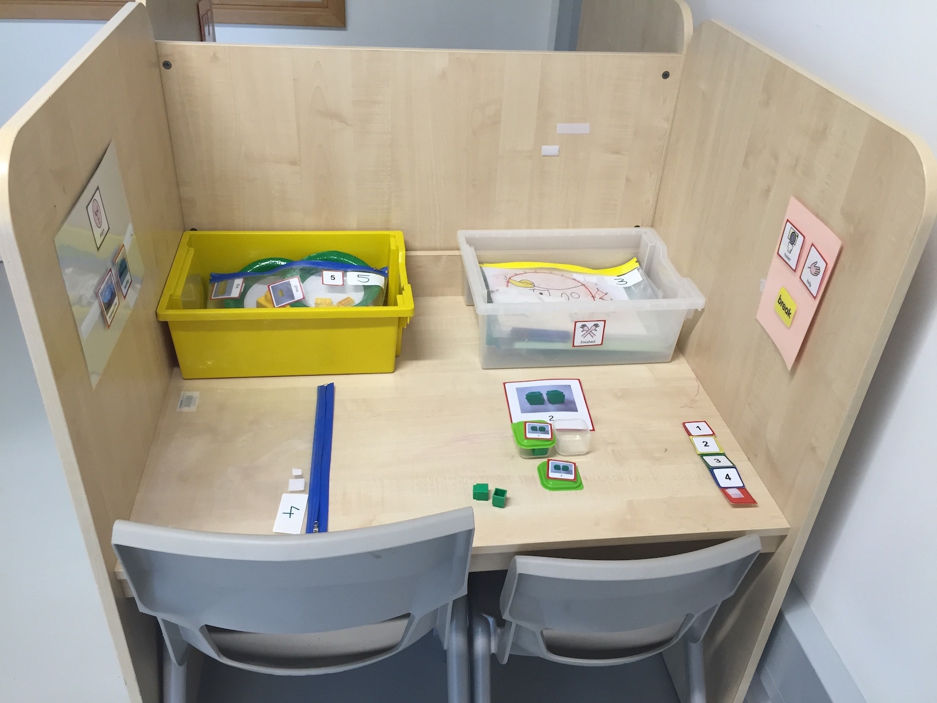
Why use a workstation approach?
Workstations are a structured teaching approach which enable pupils to:
Concentrate for a period of time
Organise their work
Increase engagement with a task
Complete tasks set
They are an effective tool for responding to the particular learning styles of pupils with Autism and/or learning difficulties by providing clear visual cues, structure and organisation.

Slide 4
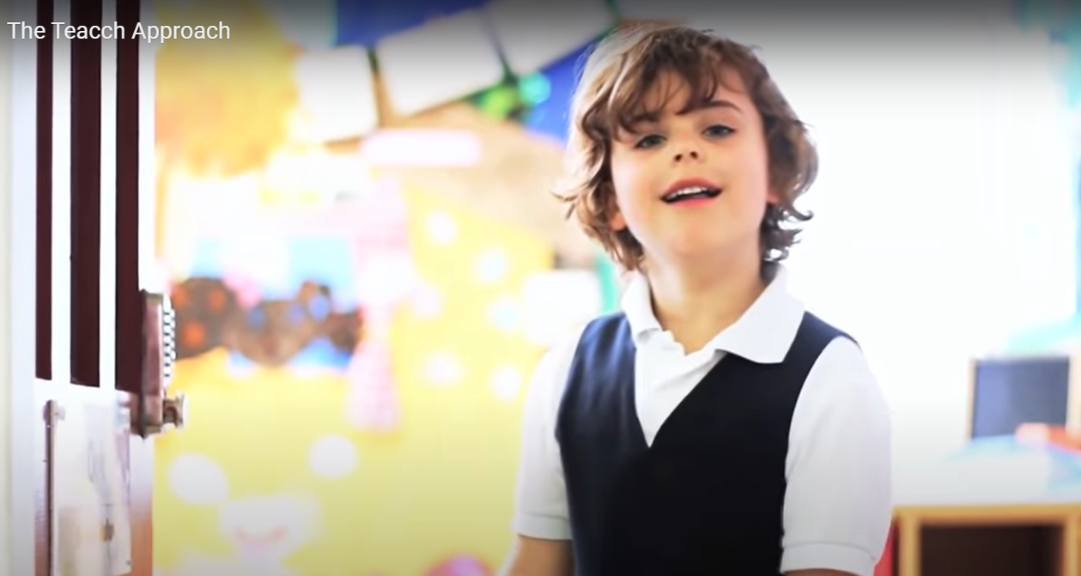
https://www.youtube.com/watch?v=vkymZzmg4jw

Slide 5
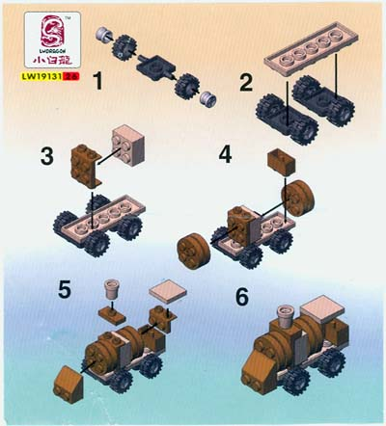

Activities with a clear finish:
not
“I know what to do and I can see when I’m finished.”
“I can keep going for as long as I like”

Slide 6

“Give me time to process.”
Put two in your head, and count on two
What is two plus two?
Use your number line
Are you listening? Come on, what is two add two?

Slide 7



“Lots of noise, light, heat, smells, texture or other stimulation can greatly disrupt me.”

Slide 8
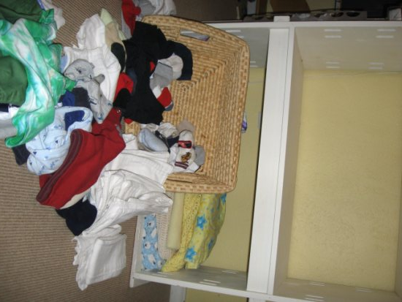
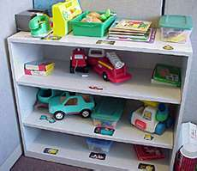
“If you do not organise and structure things for me, I will do it myself and you will find it hard to change what I have done.”

Slide 9

“I have a good memory, but not a good sense of sequence.”
“Knowing what to expect is important to me. I hate uncertainty and ambiguity.”

Slide 10


“If you don’t tell me what to expect, I will make my own assumptions based on what occurred last time.”
Fruit
Swing
Hoop
Finished
Playtime?

Slide 11
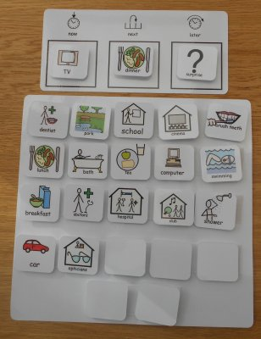

“If you can help me make sense of what you are requesting or what I am doing, my confidence goes up and my anxiety goes down.”

Slide 12

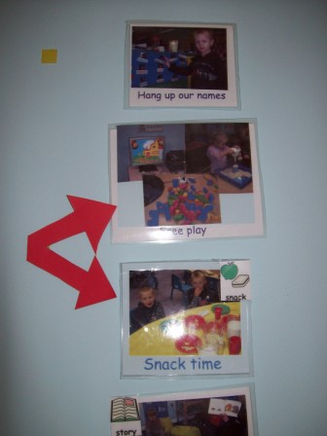
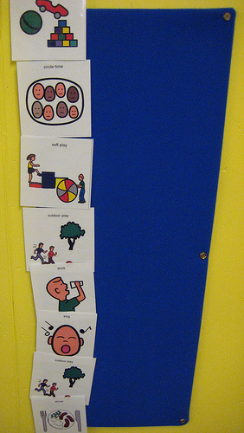
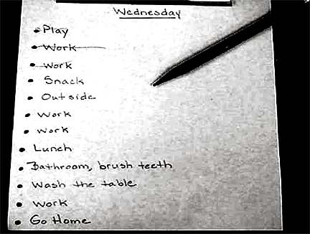
Schedules
Visual cues to indicate what will occur and in what sequence:
Objects, photos, symbols, words

Slide 13
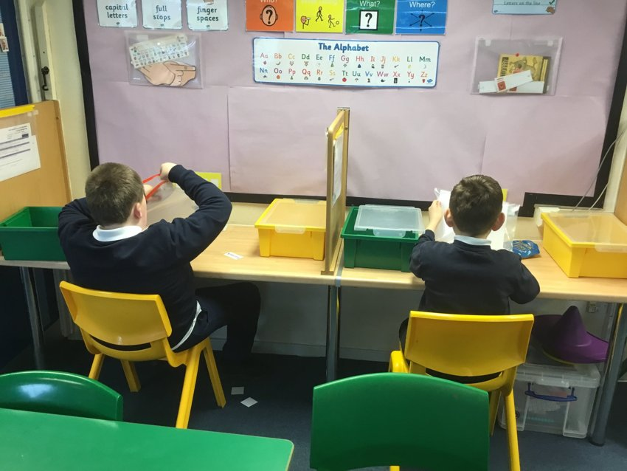
Introducing a workstation
Work stations are visually structured organisational systems to help pupils to complete tasks effectively and to understand the following:
What work do I have to do?
How much do I have to do?
How do I know I am making progress, how do I know when I am finished and where do I put the work when it is complete?
What will I do next?

Slide 14
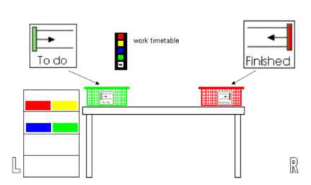
Working direction
Generally, for pupils with ASC or additional learning difficulties, the system should be organised from left to right.
Work is placed on the left of the pupil (either in a single or multiple trays/baskets).
The pupil should be taught the left to right sequence and that their work is completed when everything from the left has moved to a ‘finished’ tray on their right.

Slide 15
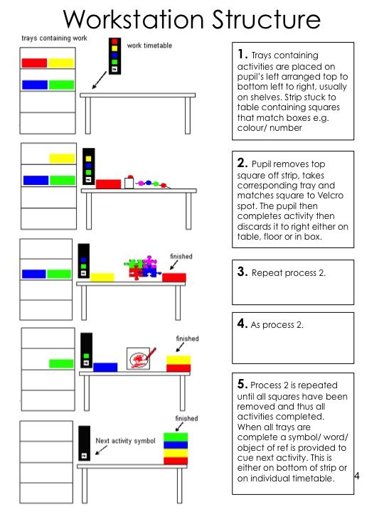
Organisation
of the Workstation

Slide 16
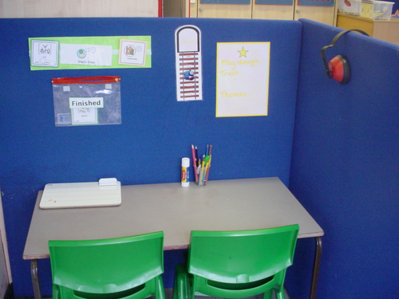
Promoting independence
To promote:
Independence in carrying out tasks
Independence in the environment
Independent use of resources
Concentration skills
The key objective is learning to work
independently – not taking on new
curriculum learning, or exploring new concepts.

Slide 17
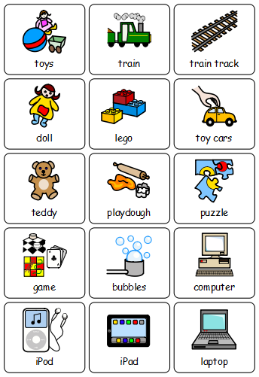
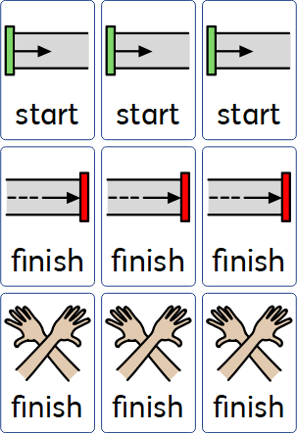
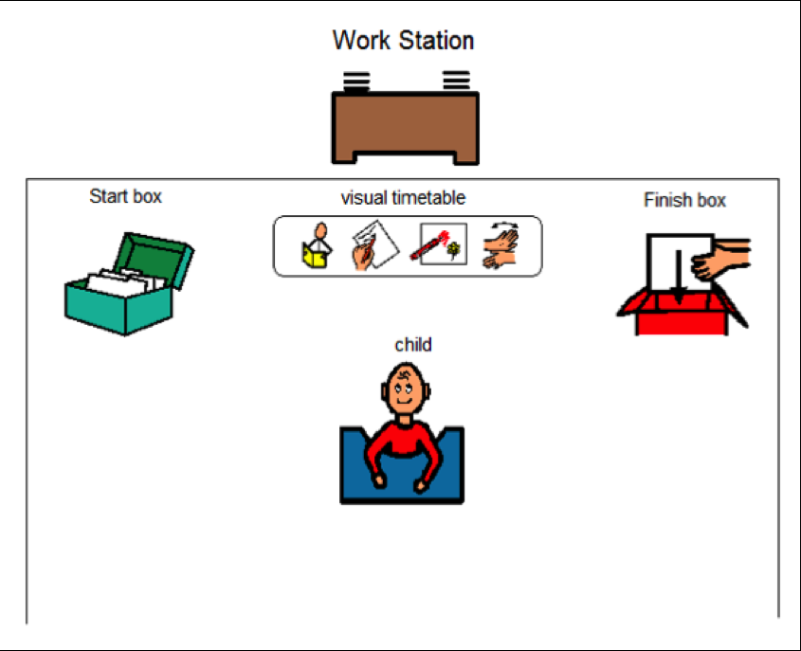
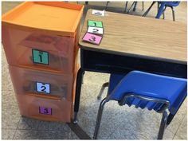
Use of visual supports

Slide 18
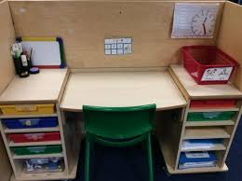
Independent Workstation Activity Resource Ideas
Literacy based tasks – e.g. letter formation, phonics activities, phoneme frames, matching and reading tasks
Maths based tasks – number formation, matching numbers/quantities, counting tasks, shape matching, ordering of numbers, sorting & classifying, sequencing activities, small jigsaw
Construction – building a model by copying a picture/instructions, building towers, copy a pattern, copying a picture with Geo-shapes
Fine motor – scissor skills, pencil control tasks, bead threading to copy a pattern, moving objects between containers with tweezers, fastenings board

Slide 19
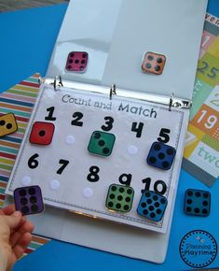
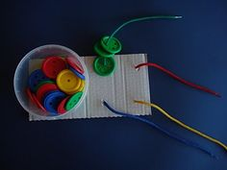
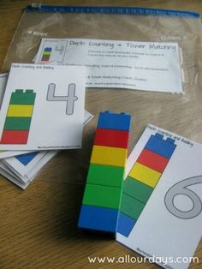
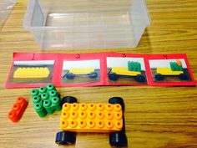
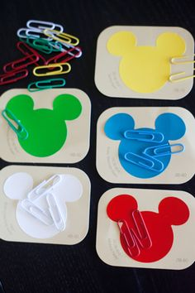
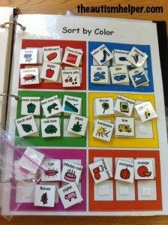
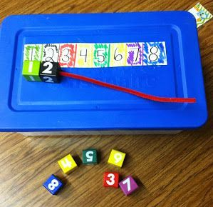
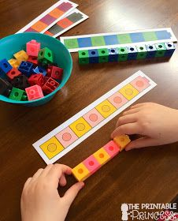
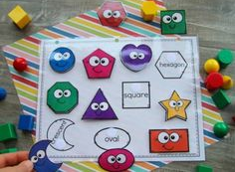
Independent Workstation Activity Resource Ideas

Slide 20
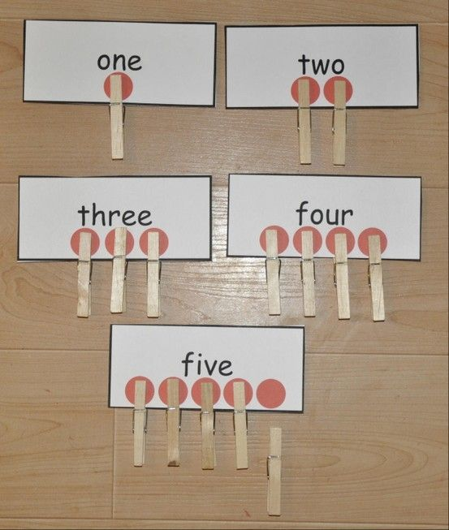
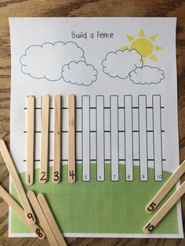
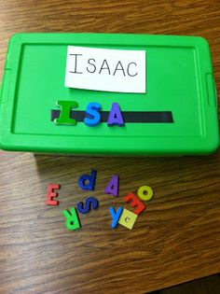
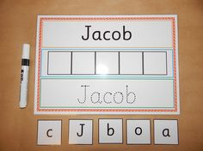
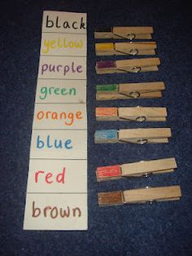
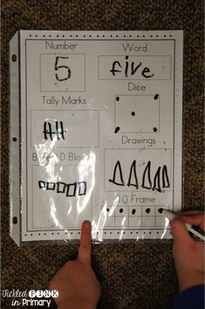
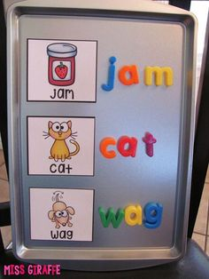
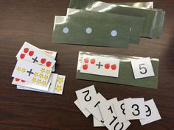
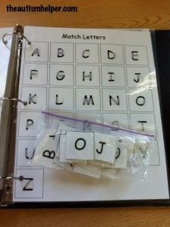
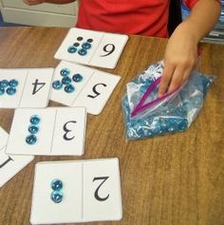
Independent Workstation Activity Resource Ideas

Slide 21
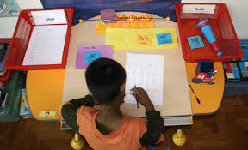
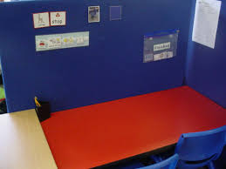
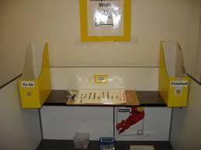
Any questions?
sarah.b@st-nicholas.kent.sch.uk

